Slide 1
COPYRIGHT
A Quick Overview
Notes:
At the previous D5 Meeting of The Societies, I was asked to present how to create content, particularly a how-to video. Instead of doing that, I thought I would focus on something that most people overlook and can make the difference between having a successful content channel and receiving take-down notices or getting sued. That means Copyrights.

Slide 2
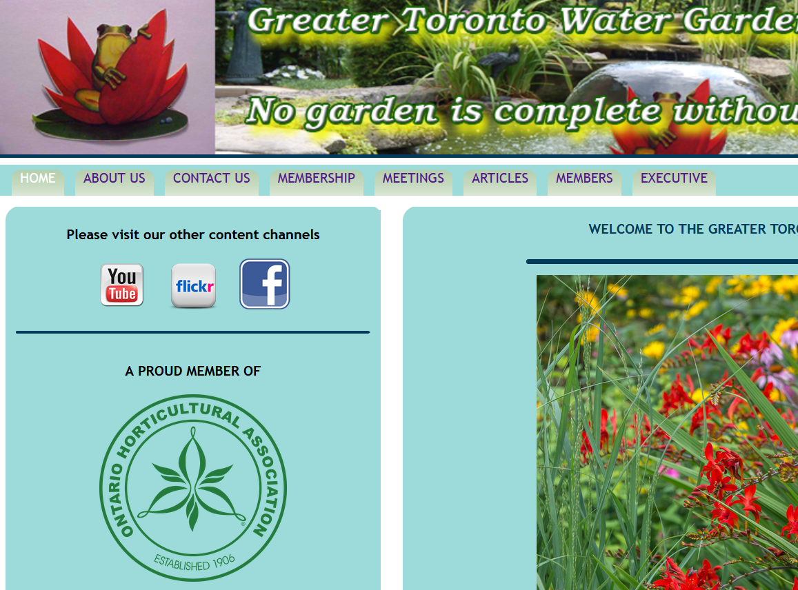
www.onwatergarden.com
Notes:
What I have done is create some content which I've posted on the Greater Toronto Water Garden Horticultural Society’s YouTube channel.
(Mouse out)
If you go to our website at onwatergarden.com and click on the YouTube badge,
(NEXT SLIDE).

Slide 3
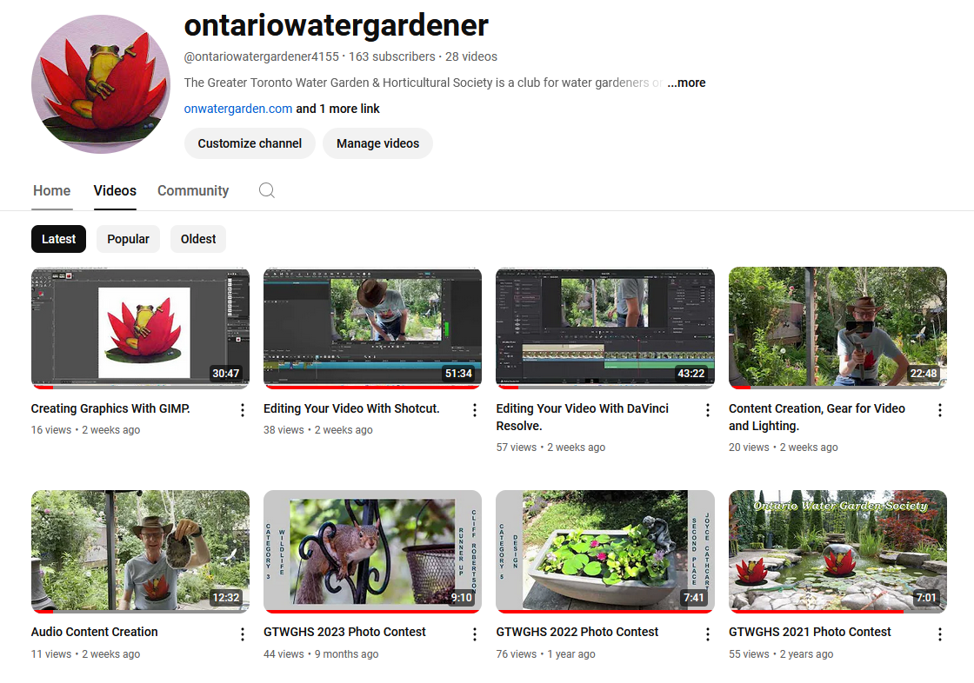
Notes:
That will take you to our YouTube channel.
(Mouse out)
Here you'll see that I've created several videos covering content creation. I've done one on creating graphics to use for your website, credits and titles, or presentations using Gimp. A couple on editing your video content in ShotCut or DaVinci Resolve. I’ve also created a video on gear such as cameras, lights, accessories etc. to make capturing your content a little bit better. I did a separate one specifically on audio because believe it or not, the audio is most important part of the video. You can go to YouTube to watch those videos if you want or share them with others. And all the software is free for personal use.

Slide 4
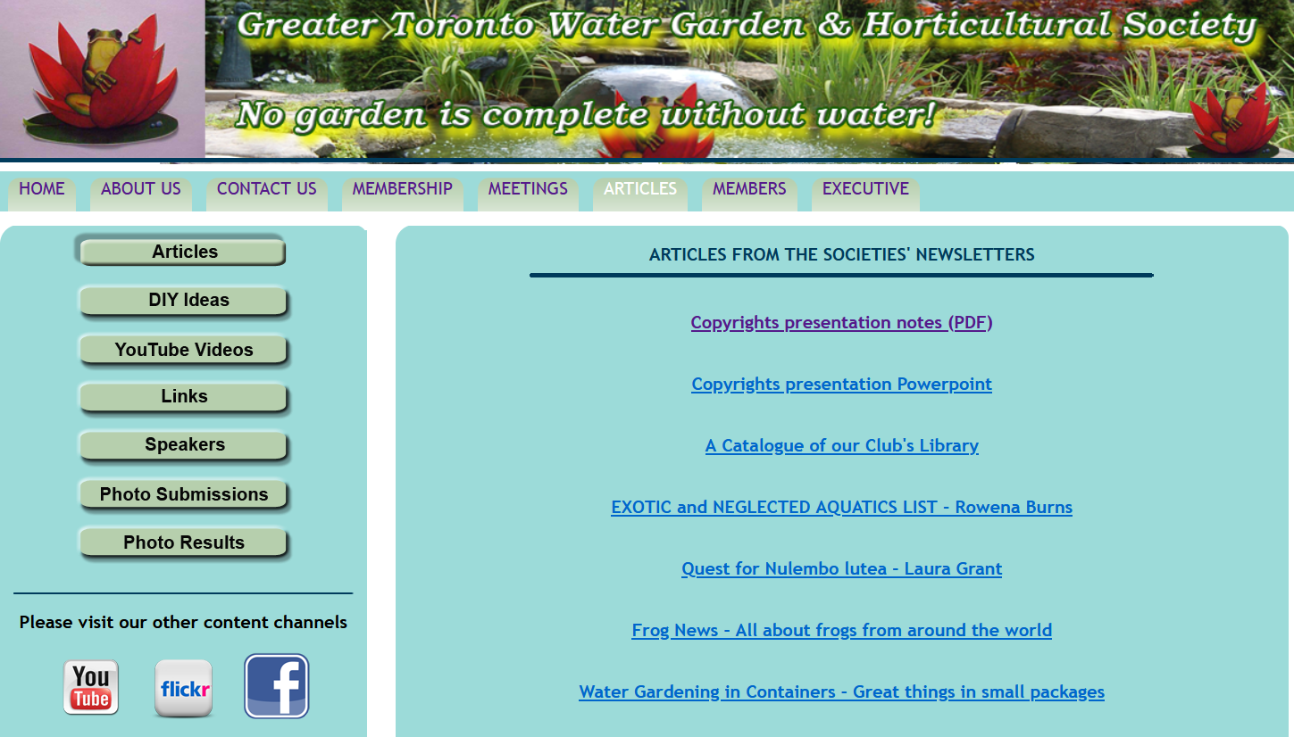
www.onwatergarden.com
Notes:
Also on our website, (Mouse out) if you go to the articles section you will find a link where you can download a PDF file that has notes, links, and stuff from this presentation today. There is also a link to download this PowerPoint presentation.

Slide 5
What is Copyright?
Copyright is the legal ownership of intellectual property with the right to control its reproduction and distribution.
A copyright is a type of intellectual property that gives its owner the exclusive legal right to copy, distribute, adapt, display, and perform a creative work.
The act of creating original content means the content is automatically protected by copyright in the country of creation.
Public Domain means any copyrights have been waived or expired. Any public domain material is unencumbered by copyright.
Notes:
So, exactly what is copyright?
A copyright is a type of intellectual property that gives its owner the exclusive legal right to copy, distribute, adapt, display, and perform a creative work.
The act of creating original content means the content is automatically protected by copyright in the country of creation. It doesn’t have to be declared or registered anywhere. Proof of creation is sufficient
Public Domain means any copyrights have been waived or expired. Any public domain material is unencumbered by copyright.

Slide 6
Copyright in Canada and the World.
Copyright law varies from one country to another.
  Most countries have copyright treaty agreements.
  Copyright is defended under the offender’s country’s law, not the creator’s country’s law.
Everything in Canada is protected by copyright automatically.
  C.I.P.O - Canadian Intellectual Property Office.
  Registration is not required. Fees run from $63 to $81.
  When you register your copyright in Canada, you get a certificate of registration that you can use in court as evidence that you own the protected work.
  Proof of creation and creation date is enough to defend copyright.
  In Canada, protection expires at the end of the 70th year after the creator dies.
  .
Notes:
Copyright laws vary from one country to another, and most counties have copyright treaties.
In Canada, the act of creating “Intellectual Property” or content, means it is automatically covered under Canadian Copyright Law.
Registering it with the C.I.P.O. is expensive, and not required.
Proof of creation and creation date is enough to defend copyright. A friend of mine is a published author, and he regularly emails manuscripts to himself.
Copyrights do expire. In Canada, protection expires at the end of the 70th year after the creator dies. Its even longer in the U.S. thanks to a certain four fingered mouse.

Slide 7
CREATIVE COMMONS
What is it?
Created by Lawrence Lessig in 2001 for the Expansion of "reasonable", flexible copyright. He is a legal scholar and professor of law at Harvard.
Creative Commons has 7 different licenses.
Creative Commons is a global standard which is recognized internationally under the current "V 4.0 International“.
Creative Commons Project Home Page: https://creativecommons.org/
Notes:
We have an even better option called “Creative Commons” copyright. It was created by Larry Lessig, a Harvard law professor in 2001. Larry is also very active in how law and the internet work together.
Creative Commons has seven different licenses made up of five components. It is also recognized internationally under most copyright treaties.

Slide 8
CREATIVE COMMONS
Why?
We want to share our content, and we want others to also share our content. This drives traffic, increases followers, and helps build community.
By share I mean link to, repost on another service or platform, or broadcast.
We also want to maintain control over how our content is shared by others.
It is easy to claim a Creative Commons Copyright License.
You simply declare Creative Commons and which of the licenses you use.
Notes:
We do want other people to share our content. This is how we drive traffic, increase followers, and build community.
This can mean linking to our content or reposting it on another service or platform, or even broadcasting it.
We do, however, want to maintain some control over how and where our content is shared.
All we need to do is to declare Creative Commons Copyright, and which license we use wherever we post our content.

Slide 9
CREATIVE COMMONS COPYRIGHT
GIVES YOU FULL CONTROL OF YOUR CONTENT.
AND CAN KEEP YOU OUT OF TROUBLE!
Notes:
Once we understand what Creative Commons is, we can use it to keep our content safe and avoid take downs and lawsuits from others by only using other Creative Commons content within our projects.
We will know that we can use images, video clips, and audio in our projects without fear if their license allows us to do so. And by projects, I don’t just mean the internet. It could be websites, videos, slideshows, presentations, or published documents such as newsletters or other articles.

Slide 10
LICENSES.
CC licenses are made up of the following 5 elements.
CC BY Attribution
CC SA Share Alike
CC NC Non-Commercial
CC ND No Derivatives
CC 0 (aka CC Zero) Public Domain
Notes:
So, let's learn a bit more about Creative Commons.
It consists of 5 different elements which, when combined, make up the 7 licenses.
Those elements are,
(NEXT SLIDE)

Slide 11
CC BY - Attribution
This license enables reusers to distribute, remix, adapt, and build upon the material in any medium or format, so long as attribution is given to the creator. The license allows for commercial use.
They need to give you credit!
Notes:
Attribution means they must give you credit for your content. This is generally done by linking back to your original content or declaring it’s source.

Slide 12
CC SA - Share Alike
This license enables reusers to distribute, remix, adapt, and build upon the material in any medium or format, so long as attribution is given to the creator. The license allows for commercial use. If you remix, adapt, or build upon the material, you must license the modified material under identical terms.
They must share under the same CC license.
Notes:
Share Alike means if they use your content in their content, they must share their content under the same Creative Commons license as yours.

Slide 13
CC NC - Non-Commercial
This license enables reusers to distribute, remix, adapt, and build upon the material in any medium or format for noncommercial purposes only.
They can’t make money.
Notes:
Non-Commercial means exactly that. They can’t use your content in any commercial project, broadcast, or performance.
This could include an OHA speaker who uses your content in their presentation if they are being paid.

Slide 14
CC ND – No Derivatives
This license enables reusers to copy and distribute the material in any medium or format in unadapted form only.
Content cannot be modified or edited in any way.
They must use it in its entirety.
Notes:
This one means they cannot modify, chop up, sample, or change your content. It must be used unmodified in its entirety.

Slide 15
CC 0 - (CC Zero) Public Domain
CC0 (aka CC Zero) is a public dedication tool, which enables creators to give up their copyright and put their works into the worldwide public domain. CC0 enables reusers to distribute, remix, adapt, and build upon the material in any medium or format, with no conditions.
You have permanently waived your copyrights.
Notes:
And of course, CC Zero or “Public Domain” means you have waived your copyrights and have entered your content into the public domain.

Slide 16











CC BY
CC BY-SA
CC BY-NC
CC BY-NC-SA
CC BY-ND
CC BY-NC-ND
CC0
Attribution
Attribution,
Share Alike
Attribution,
Non-Commercial
Attribution,
Non-Commercial,
Share Alike
Attribution,
No Derivitives
Attribution,
Non-Commercial,
No Derivitives
Public Domain
Notes:
And here are the seven licenses and their graphic representations.
(Mouse out)
Attribution
Attribution, Share Alike
Attribution, Non-commercial
Attribution, Non-commercial, Share Alike
Attribution, No Derivatives
Attribution, Non-commercial, No Derivatives
And CC-Zero or Public Domain.
Notice that every one of them contains Attribution except CC0.

Slide 17
Video Content Provided by: Cliff Robertson
Creative commons music is:
Drops of H20 (The Filtered Water Treatment) by J. Lang (feat. Airtone)
Courtesy of www.ccmixter.org
All video content is property of
Greater Toronto Water Garden & Horticultural Society.
This work is copyright.
Creative Commons:
Attribution,
Non-Commercial,
No Derivatives,
Share Alike.
V 4.0 International
©2024
Notes:
So how do you declare a CC license and give credit to other content such as images, video clips, or music that you may have used in your project?
Here is how I do it in the credits at the end of each of my videos. I also have it posted on my website and other platforms such as YouTube.
(Mouse out)
You can see I’ve given credit to the music I’ve used in the video as well as its source.
I’ve also declared my own CC-A-NC-ND-SA license and the year of creation.

Slide 18
The licenses including CC0 cannot be revoked. Once you apply a CC license to your material, anyone who receives it may rely on that license for as long as the material is protected by copyright, even if you later stop distributing it.
Notes:
All Creative Commons licenses once declared cannot be changed or revoked.
Basically, if I find an image or piece of music and the license allows me to use it, I don’t have to worry about the creator changing the license later and then suing me.

Slide 19
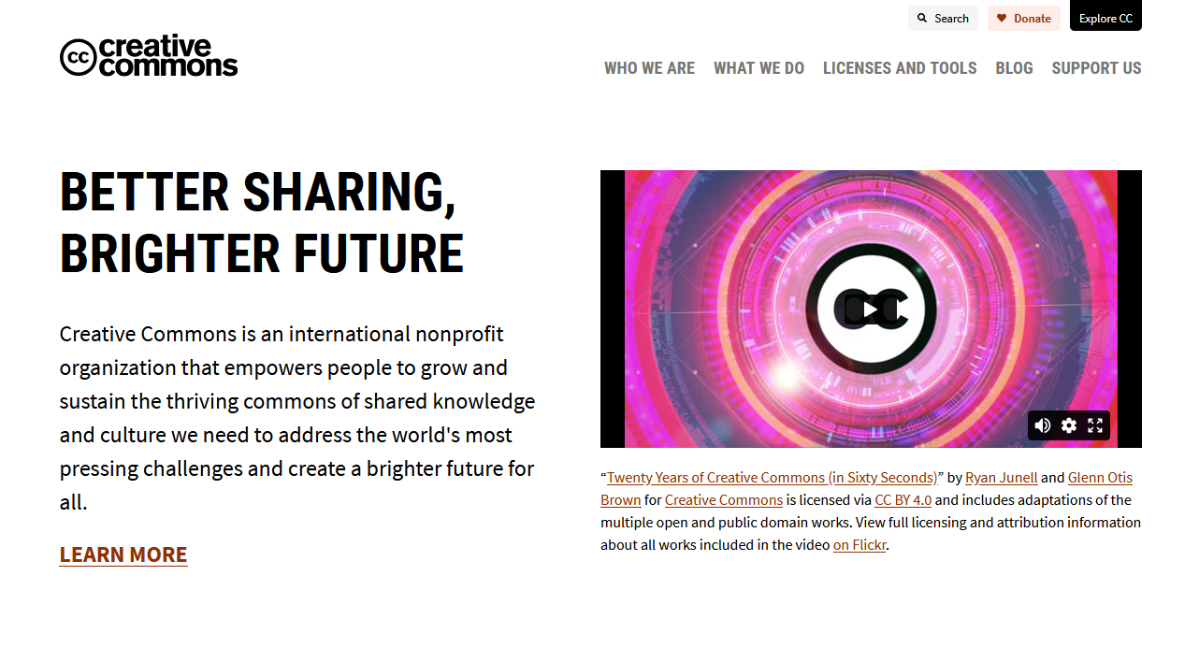
https://chooser-beta.creativecommons.org/
Notes:
The CreativeCommons.org website has all the info you would ever want (Mouseout) and in the “Licenses And Tools” section.
(NEXT SLIDE)

Slide 20
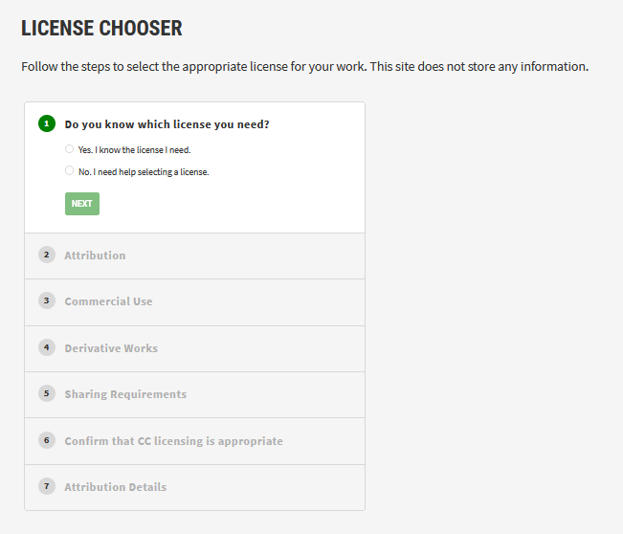
https://chooser-beta.creativecommons.org/
Notes:
You will find a license chooser.
(Mouse out)
You simply answer a series of questions.

Slide 21
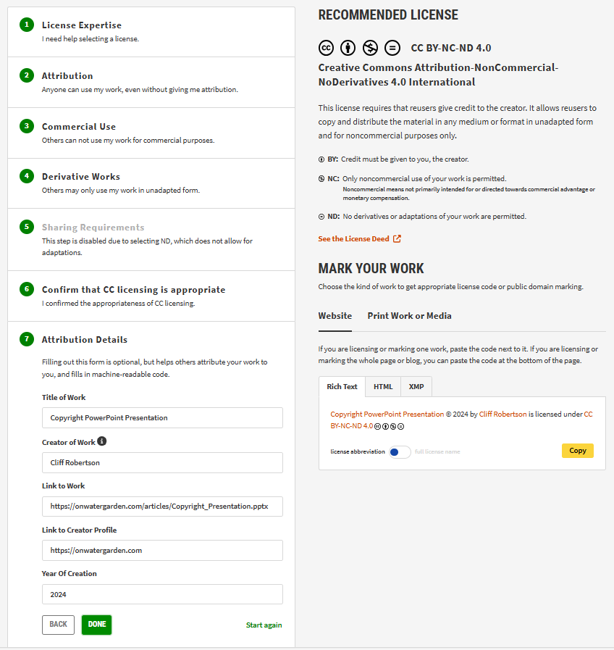
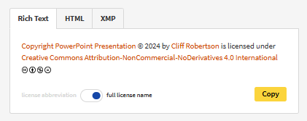
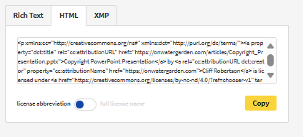
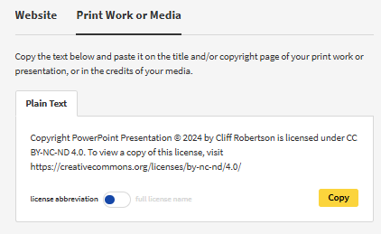
Notes:
(Mouse out)
And give some details about the content such as title, creators name, a link to the content and creator, and the year of creation.
Once you are done, you will see your “recommended License”, some details and some code you can use. You get Rich Text, Rich Text Abbreviated, as well as some HTML code that you can copy and paste into your website or other platform.
Now that we understand Creative Commons Copyright, we know that we could use other Creative Commons media in our own projects such as images, music, video clips, etc. and we can do so without getting into trouble by violating someone else's copyrights.
So where do we find all this Creative Commons content?

Slide 22
Where to get CC Content
Music:
CCMixter http://dig.ccmixter.org/
Pixabay https://pixabay.com/
Free Music Archive https://freemusicarchive.org/home
Incompetech https://incompetech.com/wordpress/
Chosic https://www.chosic.com/free-music/creative-commons/
Notes:
There is a lot of Creative Commons content out there.
Most of the big content sites like Shutterstock, iStock Photos, and Pond 5 are commercial sites which charge for their licensed content and hold the copyrights.
Facebook, TikTok, Instagram, and other platforms can also be a problem since they are covered by copyright unless declared as Creative Commons or public domain.
Here are several places to find music. This could be background music, sound bites and sound effects, or even full songs.

Slide 23
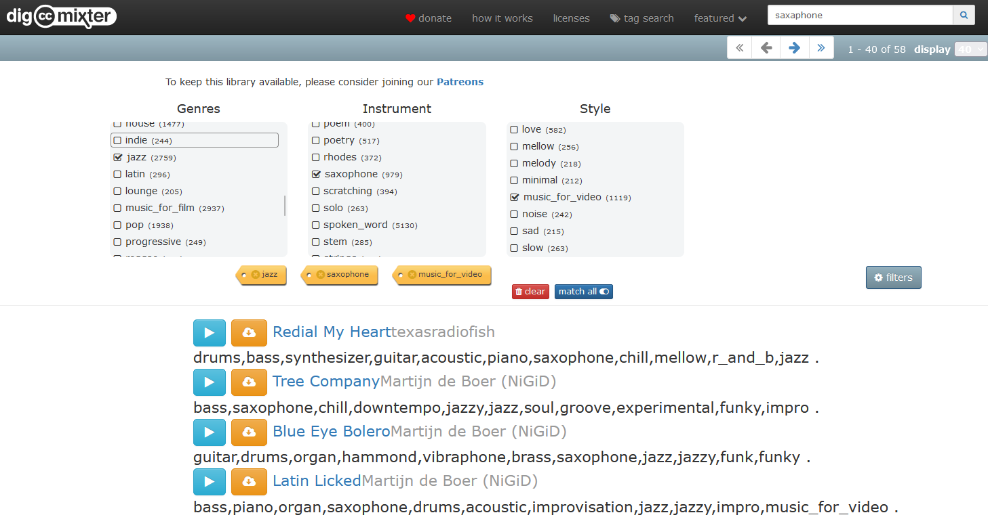
Notes:
CCMixter.org has been my go-to for almost 20 years. They have a general search box, or I can easily search by genre, instruments, and styles. I can quickly preview the tracks to find what I want. I can then download the tracks as well as their CC license info.

Slide 24
Where to get CC Content
Images and Video:
Pexels https://www.pexels.com/creative-commons-images/
Openverse https://openverse.org/
Unspalsh https://unsplash.com/
Notes:
Here are several sites for images and video clips. Pexels is one I've used quite often along with Openverse. Unsplash is one I discovered recently, and I like what I’ve seen so far.
Some of these sites do other media as well such as music, video clips, illustrations, and graphics.

Slide 25
Where to get CC Content
Fonts:
Font Squirrel https://www.fontsquirrel.com/
POWERPOINT TEMPLATES:
Slide Carnival https://www.slidescarnival.com/
Notes:
If you are looking for a unique and distinctive font or typeface for your website, presentation, or content, Font Squirrel is a well-known source.
PowerPoint presentations can be challenging to create from scratch so it's easier to start with a template and simply add your content.
This presentation I’m using today is a template I got from Slidescarnival.com.

Slide 26
THANK YOU
Notes:
So that just about covers regular copyright, as well as Creative Commons Copyright. I’ve also covered how to use Creative Commons and how to stay out of trouble when sourcing other content for your projects.
(NEXT SLIDE)

Slide 27
THANK YOU
QUESTIONS?
Notes:
Any questions assuming anyone is still awake?

Slide 28

Free templates for all your presentation needs
For PowerPoint and Google Slides
100% free for personal or commercial use
Ready to use, professional and customizable
Blow your audience away with attractive visuals
https://www.slidescarnival.com/

Slide 29
THANK YOU

